Slide 1

THE HIGH COURT OF UGANDA AT KASESE QUARTERLY PERFORMANCE REPORT FOURTH QUARTER FY 2024/2025 1ST APRIL – 30TH JUNE 2025 HON. JUSTICE LAWRENCE TWEYANZE RESIDENT JUDGE
1

Slide 2
INTRODUCTION
Kasese High Court Circuit handles Civil and Criminal cases.
It has one Resident Judge and one Deputy Registrar assisted by eight other members of staff.
The Circuit currently has one Chief Magistrate Court Kasese.
Kasese Chief Magistrates Court has the following Sub Courts;
1.Hima G1
2.Kisinga G1
3.Bwera G1
4.L.Katwe G1 & G11
.

Slide 3






MAGISTERIAL AREAS UNDER KASESE HIGH COURT CIRCURT
Kasese | Bwera | L.Katwe | Kisinga | Hima Magisterial area
Magisterial | Magisterial | Magisterial | Magisterial
area. | area. | area. | area.

Slide 4
OPERATIONAL AND SESSION FUNDS RECEIVED BY KASESE HIGH COURT CIRCUIT
IN THE 4TH QUARTER FY 2024/2025
FUNDS ALLOCATION | AMOUNT
Operational funds | 41,400,000=
In house Criminal Session | 36,750,000=
Locus Funds | 10,560,000=
Deputy Registrar’s locus funds | 3,550,000=
RCC Coordination committee | 5,650,000=
Total | 97,910,000=
Kasese High Court received a total amount 97,910,000= (Ninty seven millions nine hundred thousand shillings o. All the funds have been accounted for.
4

Slide 5
SUMMARY OF GENERAL PERFORMANCE DURING THE 4TH QUARTER ( 1ST APRIL-30TH JUNE ) 2024/2025
Case category | Brought Forward (BF) | Registered | Completed | Pending Cases (Case Work Load) | Backlog Cases
Criminal | 113 | 43 | 87 | 69 | 02
Civil | 129 | 32 | 42 | 119 | 27
Family | 28 | 6 | 4 | 30 | 01
Land | 109 | 31 | 13 | 127 | 23
Execution | 6 | 10 | 7 | 9
Total | 385 | 122 | 153 | 354 | 53
5

Slide 7
SUMMARY OF PEFORMANCE FOR THE 4TH QUARTER
The workload for the 4th Quarter stood at 354 cases marking a decrease by 31 cases compared to 385 cases in 3rd Qtr. (FY 2024/25).
For the period under review, the Court registered 122 cases reflecting a decrease by 13 cases from the 135 cases registered in the 3rd Quarter.
The Resident Judge and the Deputy Registrar disposed of 153 cases in the period under review, which represents an increase by 20 cases compared to the 133 cases disposed of in the 3rd Quarter.
The Court has a total backlog of 53 cases as of 30th June,2025 representing a decrease by 10 cases compared to 63 cases in the 3rd Quarter.

Slide 8
WORKLOAD BEFORE EACH JUDICIAL OFFICER
As at 30th June 2025
Case category | Hon. Justice LAWRENCE TWEYANZE | HON. JUSTICE DAVID S.L. MAKUMBI | Deputy Registrar H/W NKWASIBWE IVAN | TOTAL PENDING
Criminal | 67 | 2 |  | 69
Civil | 85 | 9 | 25 | 119
Family | 27 | 01 | 2 | 30
Land | 77 | 22 | 28 | 127
Execution |  |  | 09 | 09
Total | 256 | 34 | 64 | 354
8

Slide 9
PERFORMANCE PER JUDICIAL OFFICER DURING THE 4TH QUARTER
S/N | Judicial Officer | B/F | Registered | Completed | Total Workload
1. | HON. JUSTICE LAWRENCE TWEYANZE | 244 | 85 | 73 | 256
2. | HON. JUSTICE DAVID S.L.MAKUMBI | 66 |  | 32 | 34
3. | H/W NKWASIBWE IVAN | 75 | 37 | 48 | 64
 | Total | 385 | 122 | 153 | 354
9

Slide 10
BAR CHART INDICATING WORKLOAD AND PERFOMANCE PER JUDICIAL OFFICER

Slide 11
NATURE OF DISPOSAL PER INDIVIDUAL JUDICIAL OFFICER.
S/N | Judicial Officer
 |  | Dismissed | Withdrawn | Mediation settled fully | Parties conscented | Pleabargain | Convicted | File transfered | Acquitted | Closed Administratively | Application Granted | Ruling Delivered | Appln. Not Granted | Delivered Judgment | Consent Judgment | Bill Taxed | Total
1. | Hon. Justice Lawrence Tweyanze | 25 | 01 | 05 |  |  | 09 | 02 | 05 | 01 |  | 12 | 02 | 06 | 05 |  | 73
 | Hon. Justice David S.L Makumbi | 02 | 01 |  |  | 01 | 01 |  | 04 | 03 |  | 11 |  | 09 |  |  | 32
3. | H/W Nkwasibwe Ivan | 02 | 04 | 02 | 02 |  |  | 02 |  | 14 | 06 | 03 |  |  | 02 | 11 | 48
 | TOTAL | 29 | 06 | 07 | 02 | 01 | 10 | 04 | 09 | 18 | 06 | 26 | 02 | 15 | 07 | 11 | 153

Slide 12
BAR CHART REPRESENTING TOTAL DISPOSAL PER EACH JUDICIAL OFFICER

Slide 13
PENDING RULINGS AND JUDGMENTS PER JUDICIAL OFFICER – AS AT 30TH JUNE 2025
SN | JUDICIAL OFFICER | PENDING RULINGS | PENDING JUDGMENTS | TOTAL
1 | Hon. Justice Lawrence Tweyanze | 01 | 02 | 03
2 | Hon. Justice David S.L. Makumbi | 06 | 27 | 33
3 | Deputy Registrar | 00 | 00 | 00
Grand Total |  | 07 | 29 | 36

Slide 14
A COMPARISON OF THE 3RD QUARTER WITH THE 4TH QUARTER 2024/2025 OF CASES DISPOSED OF THROUGH MEDIATION
S/NO. | Judicial Officer | Mediation (ME) | Total Completed through Mediation. | Mediation (ME) | Total Completed through Mediation.
1. | Hon. Justice Lawrence Tweyanze | 00 | 00 | 05 | 05
2. | HW Nkwasibwe Ivan | 00 | 00 | 02 | 02
 | Total | 00 | 00 | 07 | 07

Slide 15
BACKLOG CASES STATUS AS AT END OF THE 4TH QUARTER
CASE | TOTAL BACKLOG AS AT 30TH JUNE 2025
Criminal | 02
Civil | 27
Land | 23
Family | 01
Executions | 00
Total | 53
The total backlog at the Court as at 30th June 2025 stood at 53 cases. It has reduced by 10 cases from the previous Quarter that stood at 63 cases as at 31st March 2025.
Civil case backlog is the highest at 27 cases of the total case backlog at the station.
6

Slide 17
BACKLOG STATUS BEFORE EACH JUDICIAL OFFICER
AS AT 30TH JUNE 2025
S/NO | Judicial Officer | Backlog Cases
1 | Hon. Justice Lawrence Tweyanze | 50
2 | Hon. Justice David S.L Makumbi | 03
3 | Deputy Registrar | 00
 | Total | 53

Slide 18
BACKLOG DISTRIBUTION FOR THE 4TH QUARTER
 | RESIDENT JUDGE | 2023 | 2022 | 2021 | 2020 | 2019 | 2018 | 2017 | 2016 | 2015 | 2014 | 2013 | 2011 | 2010 | Grand Total
 | CRIMINAL |  |  |  | 02 |  |  |  |  |  |  |  |  |  | 02
 | CIVIL | 02 | 08 | 04 | 03 | 05 |  | 02 |  |  |  |  | 02 | 01 | 27
 | FAMILY |  |  |  |  |  |  |  | 01 |  |  |  |  |  | 01
 | LAND | 06 | 04 | 02 | 04 | 1 | 01 | 01 |  | 01 |  |  |  |  | 20
 | TOTAL | 08 | 12 | 06 | 09 | 06 | 01 | 03 | 01 | 01 |  |  | 02 | 01 | 50
 | Hon Justice David Makumbi
 | CRIMINAL
 | CIVIL
 | FAMILY
 | LAND | 02 |  |  |  |  |  |  |  |  |  | 01 |  |  | 03
 | TOTAL
 | GRAND TOTAL |  |  |  |  |  |  |  |  |  |  |  |  |  | 53

Slide 19
BACKLOG DISTRIBUTION
Explanatory Notes
In the period of 3 Months, Kasese Circuit disposed of 10 cases in the 4th Quarter out of 63 total backlog cases from the 3rd Quarter. There are 7 backlog cases which are more than 10 years. All these cases are either on hearing or pending ruling/judgment.
All backlog cases for both civil and land are also causelisted for a session that is commencing on 18th August 2025 before Hon Justice Lawrence Tweyanze.
Out of 53 cases, 3 cases are already fixed for Judgement before Hon Justice David S.L Makumbi.

Slide 20
BACKLOG COMPARISON BETWEEN THE 4TH AND 3RD QUARTER
S/N | CASE CATEGORY | Case Backlog 4th Quarter FY 2024/2025 | Case Backlog 3rd Quarter FY 2024/2025
1 | CIVIL | 27 | 28
2 | LAND | 23 | 22
3 | FAMILY | 01 | 01
4 | CRIMINAL | 02 | 12
5 | EXECUTION | 00 | 00
 | TOTAL | 53 | 63

Slide 22
IMPLEMENTATION OF RESOLUTIONS AND RECOMMENDATIONS FROM THE PREVIOUS MEETING
Timely writing and delivery of judgments and rulings by both the Deputy Registrar and the Resident Judge.
Weekly tracking of all cases pending judgments.
Most decisions are delivered online and where certified copies are needed, the same are availed to the parties on the same day.
Organizing awareness meetings which lay out the proper mechanism for checks and balances in the administration of justice. As earlier stated, we had a stakeholders meeting.
Continuous maintenance of an open door policy to stakeholders and the public.

Slide 23
IMPLEMENTATION OF RESOLUTIONS … CONT’D
Weekly reports made for completed cases.
Weekly cause listing of new cases.
Limited adjournment of cases.
Consistent supervision of staff involved in entry of statistical data into CCAS.
Simultaneous handling of both old and new cases and hearing both Civil and Criminal cases on the same day.
Coordination with concerned stakeholders such the ODPP - Kasese, Justice Centers Uganda - Kasese, the Police and Prisons, in order to strengthen administration of justice.

Slide 24
IMPLEMENTATION OF RESOLUTIONS … CONT’D
Routine data integrity checks on CCAS and appropriate supervision.
Some training and capacity building for court staff on data management was internally conducted.
Regular Staff and Bar-Bench meetings held to enhance efficiency and gather feedback on service delivery.
We have continued to sensitize and encourage court users to embrace ADR.

Slide 25
BEST PRACTICES
Monthly and impromptu staff meetings.
Quarterly meetings for all judicial officers within the Circuit.
Open Door Policy.
File Movement Books for all categories of files.
Improved record keeping and management.
Prompt handling of complaints and provision of feedback.

Slide 26
BEST PRACTICES … CONT’D
Weekly and monthly reports by the court and by each staff.
Constant weeding out of non-starter files.
Financial management and accountability: the court has a finance committee, chaired by the Judge, with the D/R, OS and Cashier.
Regular monthly inspections and supervisions of the Courts in the jurisdiction.

Slide 27
CHALLENGES
The funds provided as Operational Funds are still insufficient to cater for all essential needs at the station.
Inadequate office space and furniture for staff, advocates and litigants at the court.
Inadequate Office space for the different Court staff since Kasese High Court is sharing premises with Kasese Chief Magistrates Court.

Slide 28
CHALLENGES … CONT’D
Inadequate number of staff: The court needs a Transcriber (1), a Data Entry Clerk (1) and a Records Officer (1).
Power outages that interrupt the business of Court. Whereas the premises have solar, the same is not strong enough to power the electronic equipment used. There is a need for upgrading the said solar.

Slide 29
STRATEGIES FOR PERFORMANCE ENHANCEMENT
Continuous weeding out of cases; with or without notice.
Regular cleaning of CCAS.
Case backlog sessions and daily hearing of Criminal cases.
Daily hearing of cases.
Setting aside some days for writing rulings and judgments.
Holding of regular stakeholders’, Court users’ and Bar- Bench meetings.
Improved communication with all stakeholders.
Prompt and effective handling of complaints.

Slide 30
WORK PLAN FOR THE FOURTH QUARTER JULY- SEPTEMBER 2025
SN | PLANNED ACTIVITY | VENUE | NO.OF CASES | COST (UGX) | ACTION OFFICER
1. | CRIMINAL SESSIONS | 1 CRIMINAL SESSION AT KASESE | 40 | UGX 36,750,000/= | RESIDENT JUDGE
2. | PLEA BARGAIN SESSION | SEPTEMBER 2025 | 40 | UGX 25,000,000/= | RESIDENT JUDGE
3. | INSPECTION OF TWO COURTS | SEPTEMBER 2025 |  | UGX 7,500,000/= | JUDGE & DEPUTY REGISTRAR
 |  | TOTAL |  | 69,250,000=

Slide 31
No. | Activity | Frequency | No. of cases | Total Costs
4. | Criminal Session funds | - | 45 | 36,750,000/=
5. | Court Operations and Staff Welfare | - | - | 41,400,000/=
6. 7. | RCC Meeting | Quarterly | - | 5,650,000/=
 | Judge Locus funds | Quarterly | - | 10,560,000/=
 | Registrar Locus funds | Quarterly | - | 3,550,000/=
Grand Total |  |  |  | 97,910,000/=

Slide 32
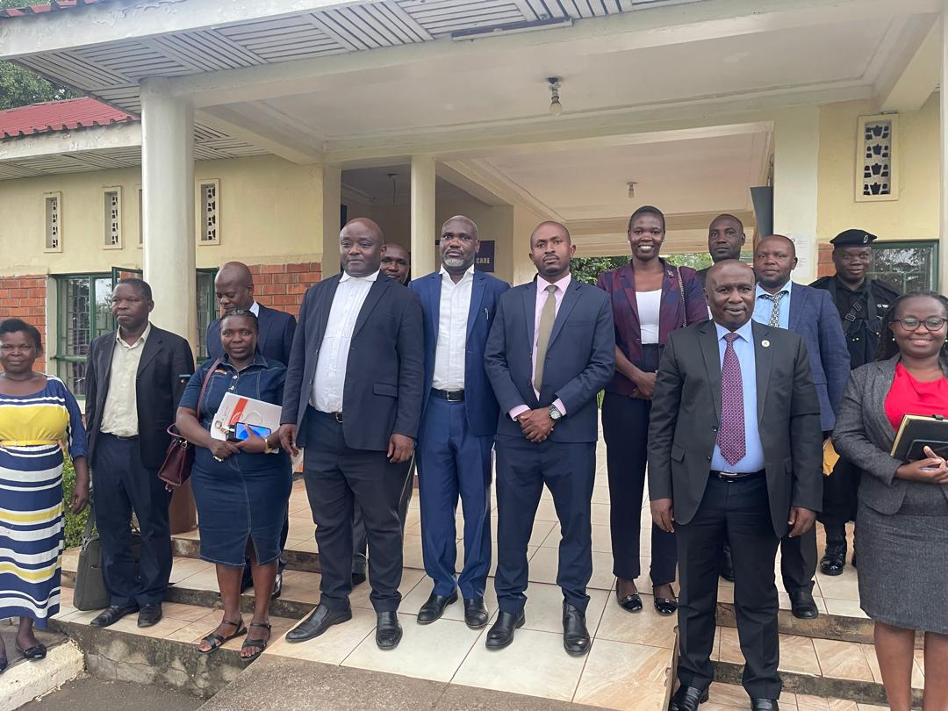
Kasese Bar Bench meeting held at Kasese High Court

Slide 33
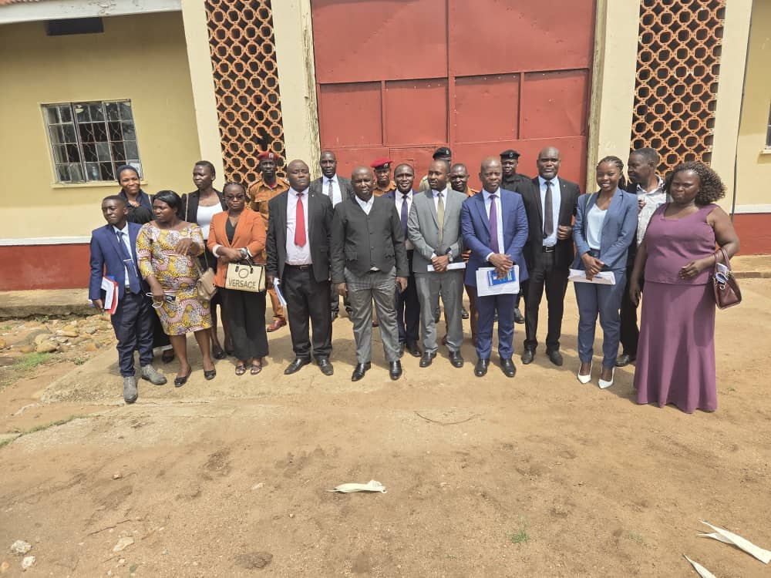
Sensitization Team at Mubuku Prison led by the Resident Judge Kasese High Court

Slide 34
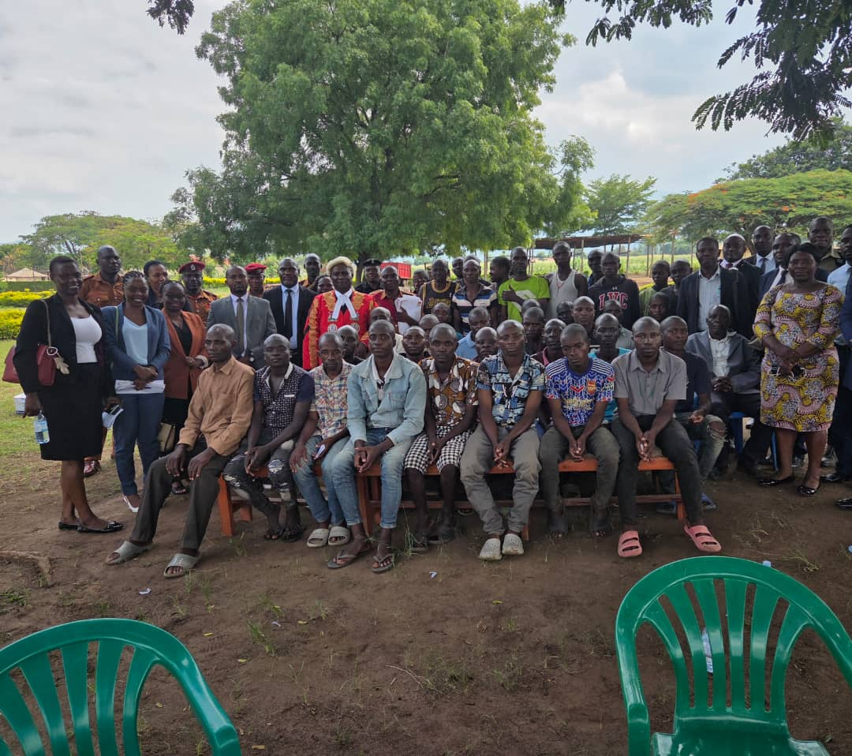
Sensitization and Interaction with inmates at Mubuku Prison

Slide 35
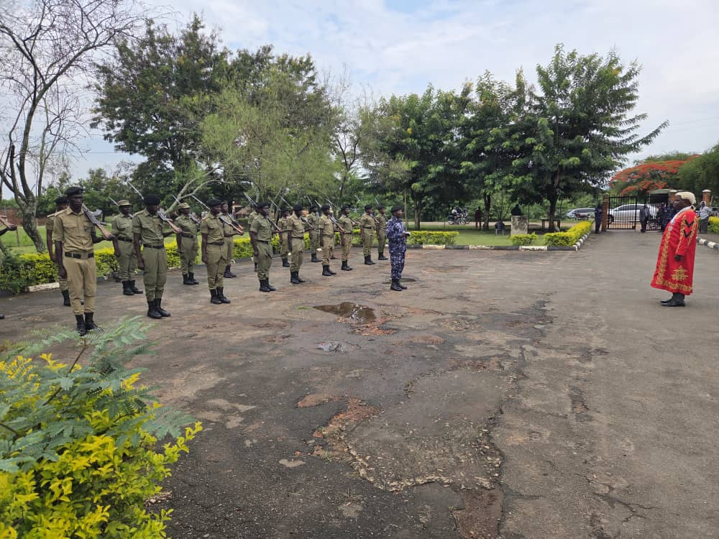
Resident Judge inspecting guard of honor at the opening of the criminal session at Kasese High Court.

Slide 36
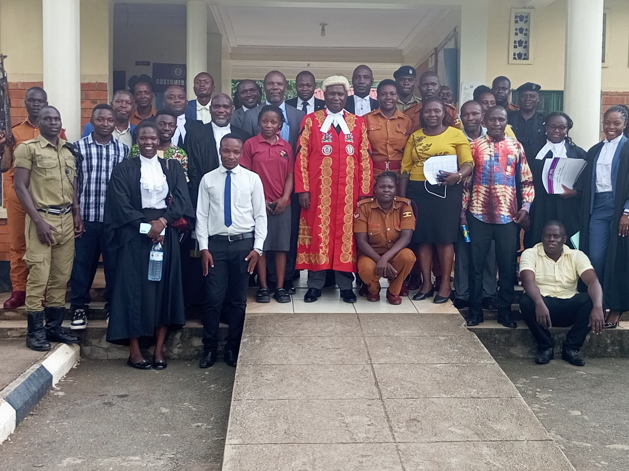
Closure of the session

Slide 37
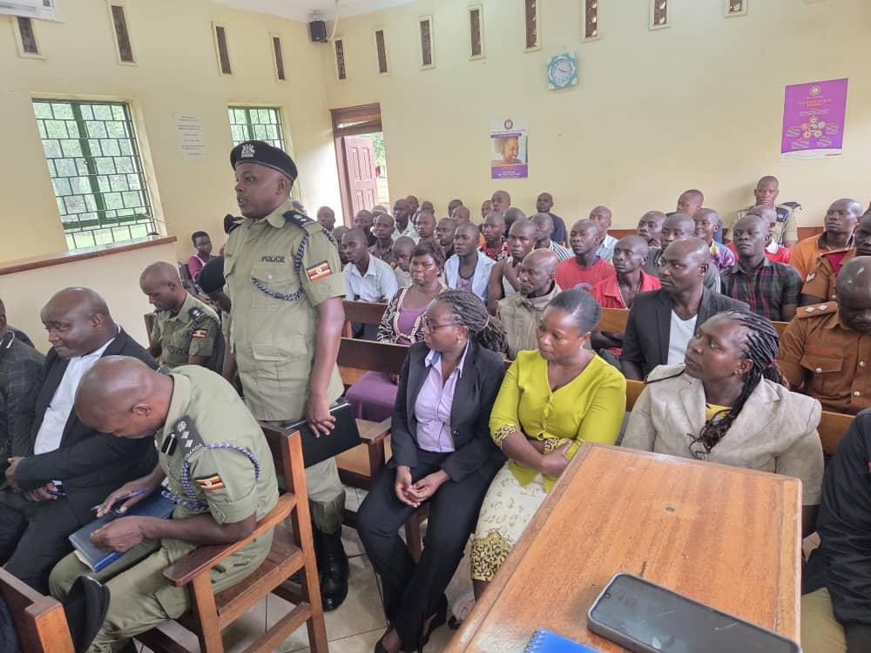
RCC Meeting conducted at Kasese High Court

Slide 38
-
THANK YOU FOR LISTENING

